Slide 1
Costs of Stunting
Names
Date

Slide 2
Agenda
20 min presentations
20 mins for Q/A
20 min for discussion – guided by our own questions
4-5 core questions

Slide 3
Presentations
1-2 slides on project goal/ sub-objectives
1 slide overview of key methods
(no more than 5 mins)
Longitudinal dataset approach vs calibration (losses to the worker individual level)
Longitudinal approach: YL, Brazil (focused set of countries)
Cleaning, merging, harmonizing datasets: 1 slide for YL countries (Diana); similar slide for Brazil (Hana)
Public/private designation of jobs
Key covariates and outcomes; any issues you ran into when harmonizing or creating them
Used literature reviews to identify effect sizes for key areas (height, education, cognition)
Summarize your approach, databases, search terms, top identified sources/challenges; goal for all 3 searches (Jannah, 1-2 slides)
Estimation OLS, Bayesian, Machine Learning
Table of differences between the 3 techniques, pros/cons (Ramraj, 1 slide, table to compare techniques)
Back up slides 1 for each of Bayesian and Machine Learning, you compare the different techniques within that branch of methods that we considered (Ramraj)
Suite of options we considered; value/major inferences from each
Fit and accuracy statistics
Share estimates quickly: 2 slides, large table comparing 3 versions of estimates from each method, 1) only crude estimates/ measure of fit/accuracy if possible; 2) covariate adjusted estimates (Ramraj)

Slide 4
Presentations
Calibration approach: several LMICs/all LMICs
1 slide with detail on methods; what are the major distinctions between this and longitudinal approach (Michael)
Data sources: WDI, World Bank for XX variables, etc
Analytical approach
Sharing the cost estimation (individual; losses to the worker) (Michael to prepare)
Share detail on methods (1 slide)
Estimates from longitudinal approach; YL, Brazil (OLS)
Prepare a table of final estimates / with average estimates, lower & upper bounds/ sensitivity analyses (1-2 slides)
Brazil comparison using ML, Bayesian
Focused on Brazil costs using OLS, ML, Bayesian (1 slide, 1 table comparing estimates)
Wage losses to the sector (pooled dataset for YL, Brazil)
1 slide, 1 table of results comparing sectors (OLS, longitudinal data)
YL, Brazil using Calibration approach (1 slide with costs estimation)
Regional picture using Calibration approach for Africa/Asia/Latin America
Nadia to prepare; Michael share country results

Slide 5
Presentations
Estimation of losses to the firm (Michael)
Detail on methods (product function, stunting effect), surveys, how many countries (YL, Brazil)
Overall national (sampling framework to identify total number of firms), pooled countries
Subgroup: Small, medium, large business size
Subgroup: Sector for each country

Slide 6
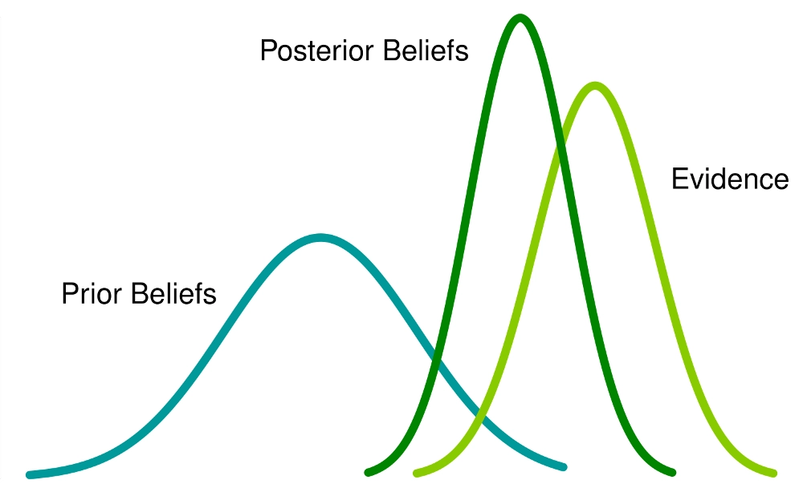
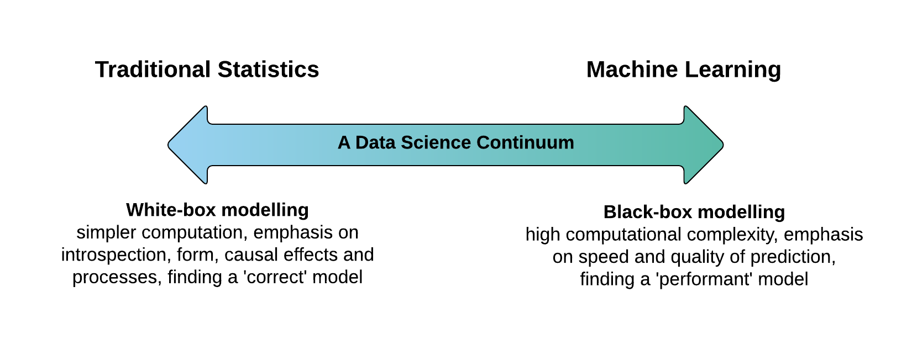
Stats vs Bayesian vs ML
Bayesian Inference

Slide 7
Comparison of different approaches
Factors | Classical Statistics approach(OLS) | Bayesian approach | ML approach
Dataset | Uses the entire dataset to fit the model | Uses the entire dataset to get posterior predictive distribution | Dataset divided into Training set, test set and validation set. Model Training is done on Training set, cross-validation on Test data and hyperparameter tuning on validation set
Assumptions | Assumptions have to be met | Relies on strong prior distributional assumptions. | minimal to no assumptions , black box models
Missing Values | Ignored | Part of the joint probability system | Automatic handling of missing values. Robust ML algorithms for imputations Eg. KNN, Random Forest
Feature Scaling | Required for better performance | Better to standardize for efficiency | Scaling not required in tree based models
Outliers | Sensitive to outliers | Robust to outliers | Robust to outliers
Variable and Model Selection | Limited techniques | Few techniques but depends on prior selection | Variety of techniques Ensemble learning, model averaging, bagging, boosting
Feature interactions | No | No | Automatically learns feature interactions

Slide 8
Comparison of different approaches
Factors | Classical Statistics approach(OLS) | Bayesian approach | ML approach
Dimensionality | Curse of dimensionality-Low prediction and interpretation | Moderate performance with computational cost | Higher dimensionality more accurate predictions
Interpretability | Simpler computation. Size of the effect, variables "explain" or affect the outcome, causal effects and processes | Bayesian statistics are better for interpretation | Interpretability/predictive power tradeoff Less interpretability- Focuses more on hyperparameter optimization and quality of prediction
Metrics | Hypothesis tests, goodness of fit measures | Credible intervals, posterior probability certainty index | MAE, MSE, RMSE, R square/Adjusted R square
Prediction Power | Lower | Lower | Higher. Increases significantly as new data comes in. Continuous improvement
Prior Assumptions | No prior assumptions | Having strong prior intuitions | ML is done in the context of “big data”. Priors - don’t actually play much of a role.
Deployment | Scalability issues, less predictive power | Scalability issues, computational cost | Auto scaling, Easier deployment to production (eg. Cloud based platforms)
Computational demand | Less computational resources | Overcoming problems with prior distribution, Sampling posterior distributions is computationally expensive and slow. | Automated-Less computational power leveraging Big data tools.

Slide 9
Crude Model Estimates before imputation
Before KNN imputation
 | Techniques
 | Linear regression |  |  |  | CI
 |  | coeff | se |  | [0.025 | 0.0975]
 | Cognition(Z score) | -0.66 | 0.056 | p-value: <.001 | -0.769 | -0.548
 | Height(cm) | -8.82 | 0.502 | p-value: <.001 | -9.808 | -7.481
Stunting | Education(yrs) | -2.83 | 0.231 | p-value: <.001 | -3.287 | -2.382
 | Bayesian Linear regression((with prior) |  |  |  | hdi_3% | hdi_97%
 |  |  | sd | r_hat
 | Cognition(Z score) | -0.67 | 0.067 | 1.0 | -0.806 | -0.555
 | Height(cm) | -7.73 | 0.597 | 1.0 | -8.781 | -6.541
 | Education(yrs) | -2.83 | 0.273 | 1.0 | -3.342 | -2.327

Slide 10
Crude Model Estimates after imputation
After KNN imputation
 | Techniques |  |  |  | CI
 | Linear regression | coeff | se |  | [0.025 | 0.0975]
Stunting | Cognition(Z score) | -0.61 | 0.04 | p-value: <.001 | -0.694 | -0.536
 | Height(cm) | -6.77 | 0.348 | p-value: <.001 | -7.451 | -6.087
 | Education(yrs) | -2.41 | 0.171 | p-value: <.001 | -2.745 | -2.073
 | Bayesian Linear regression((with prior) |  |  |  | HDI
 |  |  | sd | r_hat | [3% | 97%]
Stunting | Cognition(Z score) | -0.64 | 0.047 | 1.0 | -0.724 | -0.549
 | Height(cm) | -6.50 | 0.415 | 1.0 | -7.308 | -5.757
 | Education(yrs) | -2.45 | 0.204 | 1.0 | -2.821 | -2.067
 | LR using ML | coeff | R square
Stunting | Cognition(Z score) | -0.64 | 0.03
 | Height(cm) | -6.98 | 0.05
 | Education(yrs) | -2.47 | 0.03

Slide 11
Findings
Outcome – Height
Based on OLS approach Outcome Height – Compared to Non stunted group we would expect stunted child height in adulthood to decrease by an average of 6.77 cm (95% CI = 6.77, 6.1-7.5, p < 0.001)
Based on Bayesian approach with prior knowledge stunted child on average had decreased height in adulthood by 6.5 cm(94% CrI, 5.7 to 7.3)
Based on ML based LR approach compared to non stunted we would expect stunted child height in adulthood to decrease by an average of 6.98 cm validated by cross validation (MAE- 6.2, RMSE - 7.6, R square - 0.05)

Slide 12
Performance indicators of all ML algorithms
ML Models | Elastic net Regression | Random Forest | Extra Trees | Support Vector Machines | Gradient Boosted trees | Linear regression
Metrics
Cognition Z score
Mean Absolute error | 0.73 | 0.72 | 0.72 | 0.72 | 0.72 | *0.72
Root mean Square error | 0.90 | 0.89 | 0.89 | 0.89 | 0.89 | *0.88
R square | 0.00 | 0.03 | 0.03 | 0.03 | 0.03 | *0.04
Adult Height
Mean Absolute error | 6.29 | 6.18 | 6.18 | 6.17 | *6.17 | 6.18
Roor mean Square error | 7.82 | 7.61 | 7.61 | 7.63 | *7.60 | 7.61
R square | 0.00 | 0.05 | 0.05 | 0.05 | *0.05 | 0.05
Education
Mean Absolute error | 3.09 | 3.01 | 3.01 | *3.02 | *3.01 | 3.01
Roor mean Square error | 3.86 | 3.80 | 3.80 | *3.81 | *3.80 | 3.80
R square | 0.00 | 0.03 | 0.03 | *0.03 | *0.03 | 0.03
Notes:
* Best Model performance was achieved by Gradient boosted trees, Support Vector Machines and Linear regression on different outcomes when it comes to making accurate predictions

Slide 13
Adjusted Estimates
Before KNN imputation
 | Techniques | Adjusted for covariates
 | Linear regression |  |  |  | CI
 |  | coeff | se |  | [0.025 | 0.0975]
 | Cognition(Z score) | -0.29 | 0.061 | p-value: <.001 | -0.407 | -0.167
 | Height(cm) | -8.56 | 0.424 | p-value: <.001 | -9.39 | -7.728
Stunting | Education(yrs) | -1.03 | 0.237 | p-value: <.001 | -1.5 | -0.571
 | Bayesian Linear regression(with prior) |  |  |  | HDI
 |  | mean | sd | r_hat | [3% | 97%]
 | Cognition(Z score) | -0.32 | 0.071 | 1.0 | -0.452 | -0.186
 | Height(cm) | -8.53 | 0.5 | 1.0 | -9.474 | -7.615
 | Education(yrs) | -1.17 | 0.273 | 1.0 | -1.705 | -0.675
Covariates
Age
Sex
Age gap between parents
Years of education of the mother
Household size
Wealth Index

Slide 14
Adjusted Estimates
After KNN imputation
 | Linear regression |  |  |  | CI
 |  | coeff | se |  | [0.025 | 0.0975]
Stunting | Cognition(Z score) | -0.21 | 0.034 | p-value: <.001 | -0.281 | -0.148
 | Height(cm) | -6.21 | 0.265 | p-value: <.001 | -6.728 | -5.69
 | Education(yrs) | -0.6 | 0.14 | p-value: <.001 | -0.873 | -0.325
 | Bayesian Linear regression(with prior) |  |  |  | HDI
 |  | mean | sd | r_hat | [3% | 97%]
Stunting | Cognition(Z score) | -0.23 | 0.039 | 1.0 | -0.305 | -0.16
 | Height(cm) | -6.13 | 0.308 | 1.0 | -6.719 | -5.573
 | Education(yrs) | -0.71 | 0.165 | 1.0 | -1.018 | -0.39
 | LR using ML | coeff | R square
Stunting | Cognition(Z score) | -0.24 | 0.35
 | Height(cm) | -6.14 | 0.48
 | Education(yrs) | -0.72 | 0.4

Slide 15
Performance indicators of all ML algorithms
ML Models | Elastic net Regression | Random Forest | Extra Trees | Support Vector Machines | Gradient Boosted trees | Linear regression
Metrics
Cognition Z score
Mean Absolute error | 0.59 | 0.53* | 0.55 | 0.57 | 0.56 | 0.56
Root mean Square error | 0.76 | 0.72* | 0.75 | 0.76 | 0.73 | 0.73
R square | 0.27 | 0.36* | 0.31 | 0.29 | 0.34 | 0.35
Adult Height
Mean Absolute error | 5.56 | 4.23* | 4.26 | 5.06 | 4.47 | 4.46
Roor mean Square error | 6.98 | 5.6* | 5.69 | 6.67 | 5.66 | 5.65
R square | 0.2 | 0.49* | 0.47 | 0.27 | 0.48 | 0.48
Education
Mean Absolute error | 2.36 | 2.18* | 2.22 | 2.28 | 2.31 | 2.32
Roor mean Square error | 3.09 | 2.95* | 3.03 | 3.06 | 3 | 2.99
R square | 0.36 | 0.42* | 0.38 | 0.37 | 0.4 | 0.4
Notes:
* Best Model performance was achieved by Random Forest regression in making accurate predictions

Slide 16
Methodology

